Slide 1

Enhancing Security and Privacy for Database in Cloud Computing.
Tahir Yinka Olaosebikan (11614030132) Programme: M.Sc.(IT) [Full-Time] Registration Date: 04-18-2018 Supervisor: Assoc. Prof. Dr. Haw Su Cheng Co-supervisor: Dr. Chan Gaik Yee
Multimedia
University

Slide 2
Enhancing Privacy For Big Data Using Blockchain Technology.
Tahir Yinka Olaosebikan (11614030132) Programme: M.Sc.(IT) [Full-Time] Registration Date: 04-18-2018 Supervisor: Assoc. Prof. Dr. Haw Su Cheng Co-supervisor: Dr. Chan Gaik Yee
Multimedia
University

Slide 3
Slide Content
Introduction
Research background, Research question, Research objectives
Literature review
Proposed solutions
Preliminary result
Work progress and conclusion.

Slide 4
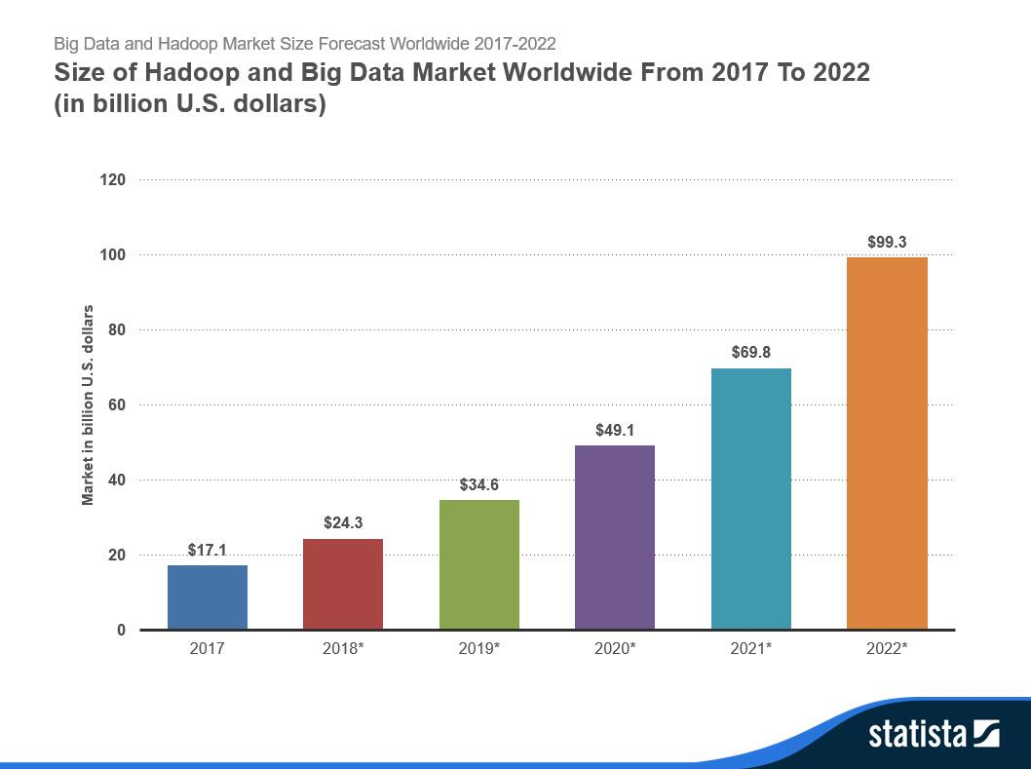
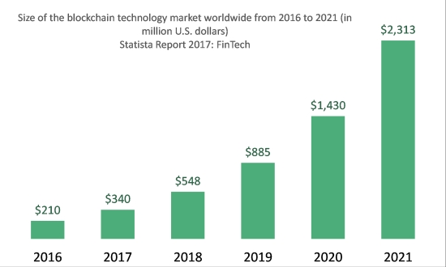
Introduction
Biggest big data” as it as of now creates 60% of web movement also, 70% of cell phone activity. ( Aljawarneh et al., 2015 )
Blockchain is completely decentralized by relying on a peer-to-peer network with light- weight authentication techniques (Mohamed et al., 2017).

Slide 5
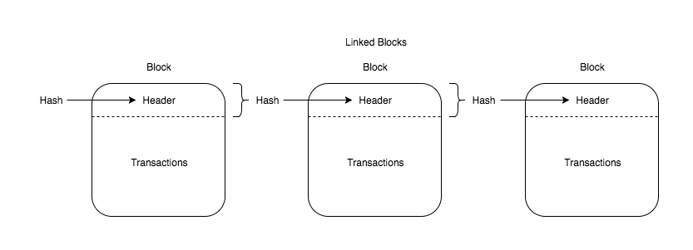
What Is Blockchain ? Key Definitions
A block is referring to files where transactions are permanently stored. E.g. a page of a ledger or an account book.
The Block:
Body
Blockchain are linked blocks of valid transactions. Blockchain could be permissioned(e.g. Hyperledger), permission-less (e.g. Bitcoin), or Consortium. (e.g. Ethereum),
The Blockchain:

Slide 6
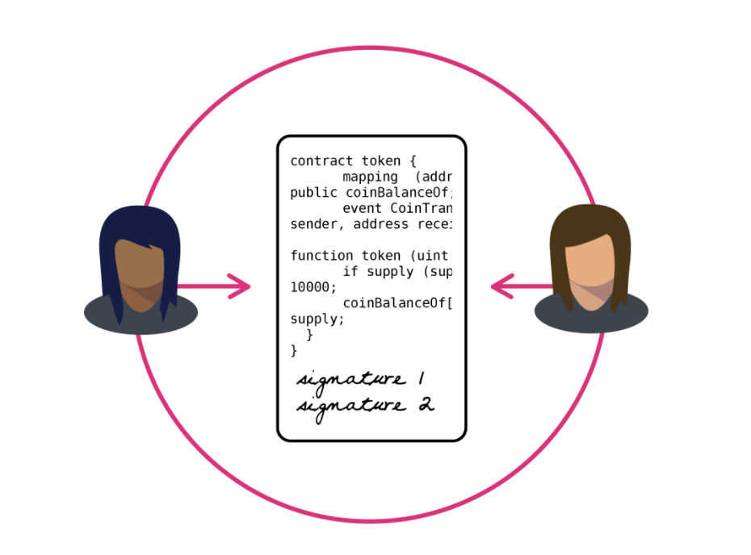
Immutable blockchain ledger that verifies and ensure that the users, transactions are legitimate. This is done via chain-code or a smart contract.
Blockchain Authentication:
Credible contract that is completely controlled by a computer program that doesn't depend on any agency
Smart Contract/ Chain-code:

Slide 7
Some Relevant definitions
Consensus algorithm:
For a block to be validated by the network peers, miners or node participants in the network must complete the, proof of work/proof of stake/PBTF.
This is a trivial mathematical puzzle solved by miners of a blockchain.
Proof 0f Work (PoW):
Network miners are chosen depending on how much of stake the miner holds in the blockchain network.
Proof Of Stake:
Practical Byzatine Fault Tolerance (PBTF):
This consensus allows generation of a new block if more than 2/3 of all validating peers post the same reactions.

Slide 8
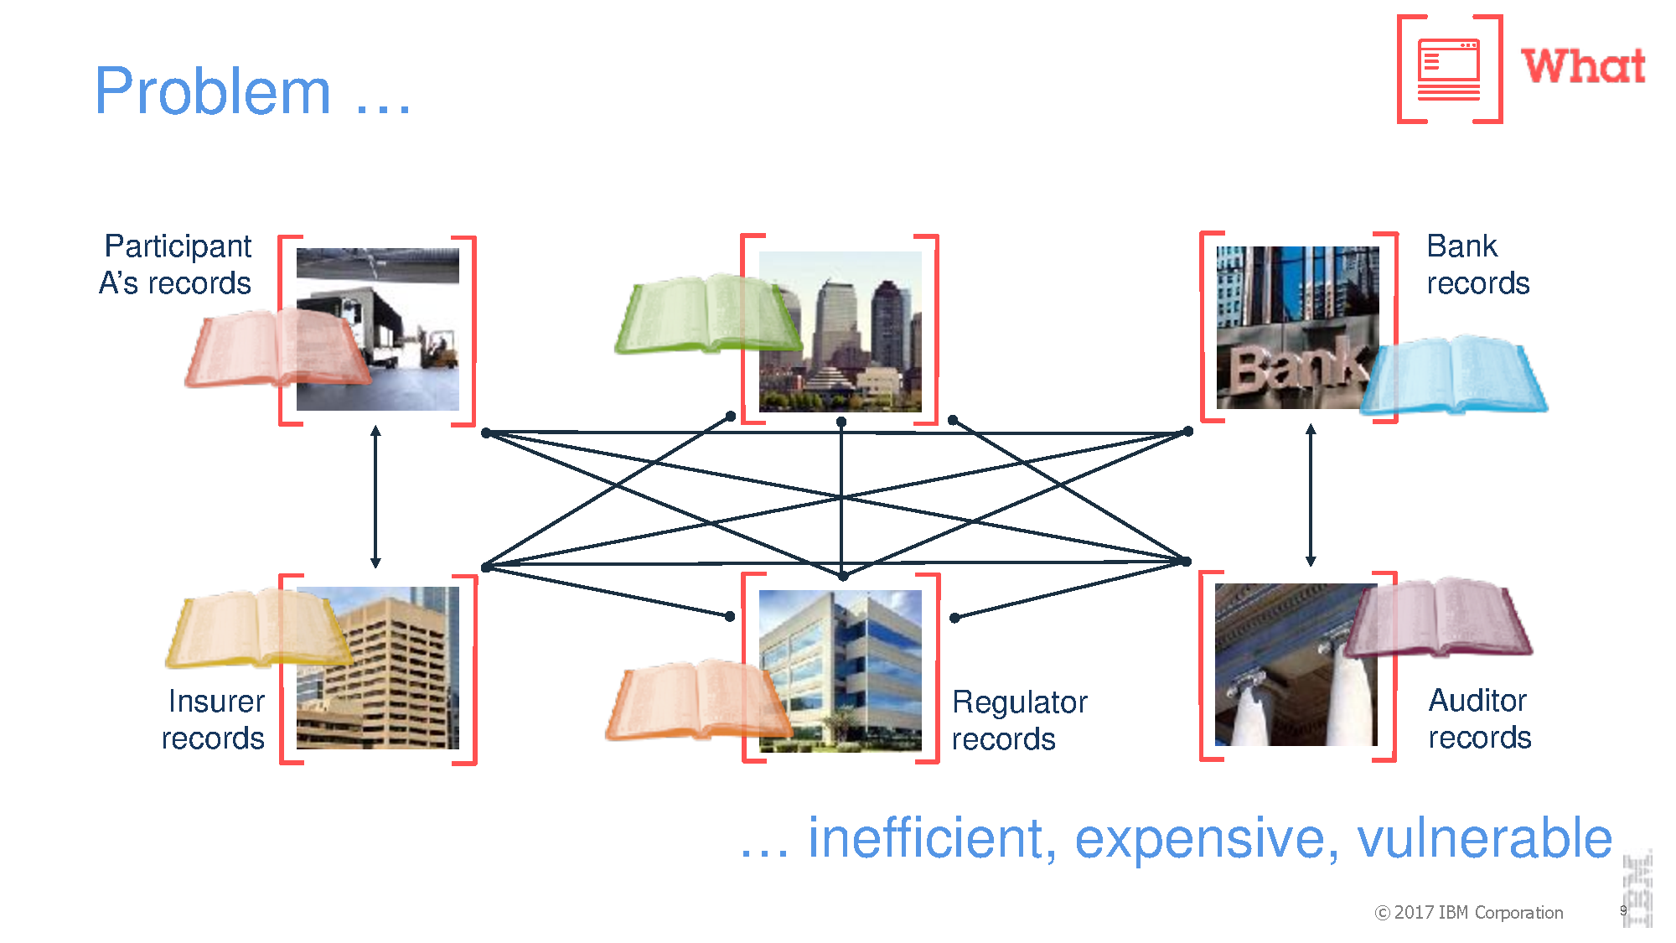
Current situation: Vulnerable to attack, centralized access procedures, expensive networking, scaling issues
Complexity in a financial networking environment. Individuals have practically zero commands over the information that is put away about them and how it is utilized. Sukhodolskiy, and Zapechnikov, 2014.
Issues are at the point of convergence as rising dangers and vulnerabilities keep on developing. Alshehri et al., 2015

Slide 9
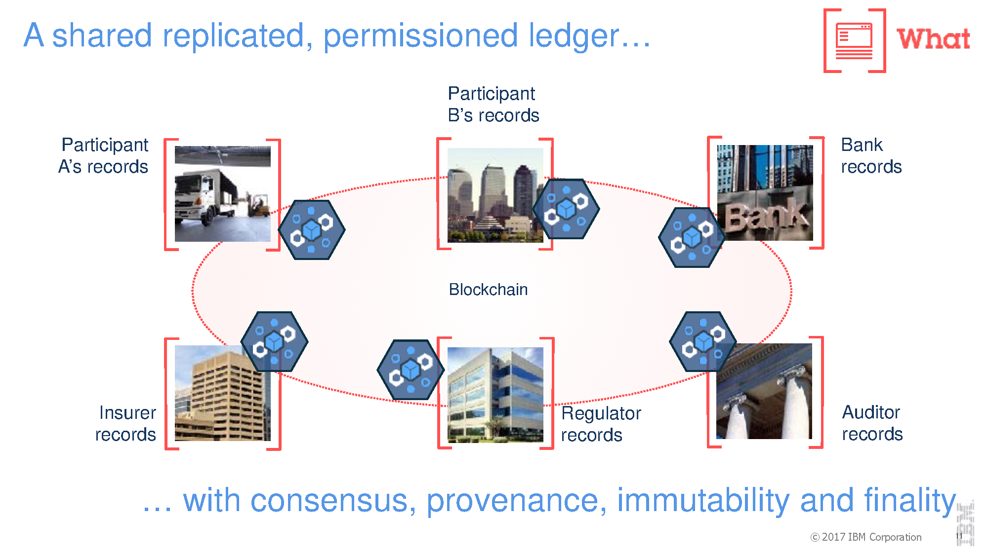
Why Blockchain ?
Solution: Decentralized access procedures, consensus algorithm, Immutability, scalable
Blockchain innovation empowers a decentralized and appropriated condition with no requirement for a central authority. (Zyskind et al., 2015)
Blockchain is completely decentralized by relying on a peer-to-peer network. More precisely, each node of the network maintains a copy of the ledger to prevent a single point of failure (Mohamed et al., 2017)

Slide 10
RESEARCH QUESTIONS AND RESEARCH OBJECTIVES :
Research Questions:
Research Objectives:
RQ1: What are the issues related to existing big data privacy under blockchain?
RQ2: How blockchain technology can overcome big data privacy issues ?
RQ3: Is the proposed solution able to perform efficiently and effectively in terms of volume and variety ?
RO1: To explore big data privacy issues under blockchain. (Answer to RQ1)
RO2: To propose and design a blockchain framework to resolve the big data privacy issues.(Answer to RQ2)
RO3: To evaluate the performance of the proposed framework as compared to existing approaches (Answer to RQ3)

Slide 11
Literature review
Review on existing Blockchain Schemes
(Decentralized Techniques)
Review on existing Cryptography Schemes
(Centralized Techniques)

Slide 12
Review on existing Blockchain Schemes
1
Why Blockchain Environment ?
To identify anonymity on blockchain: whether the identity of a node is openly transparent.
Blockchain Environment:
Bitcoin
Ethereum
Hyperledger
Why Network Management?
Access to data or resource depends on the 3 main types of blockchain.
Network Management:
Permissioned
Permission-less
Hybrid
Why Authentication Management?
Permission restrictions will determine which nodes are eligible to create blocks for records.
3. Authentication Management:
Public Key Infrastructure
Single-sign on

Slide 13
Blockchain Approach
Blockchain Environment
Bitcoin
Ethereum
Hyperledger
Hybrid
Network Management
Permission-less
Permissioned
Authentication Management
“Sing- and encrypt” Zhang et al., 2018, Zyskind et al., 2015
“Elliptic curves cryptography” Mohamed et al., 2017
“One-to-one proxy re-encryption keys” Alvetine et al., 2016

Slide 14
FHIRChain: zhang et al., 2018
Proposed FHIRChain a Ethereum framework by encapsulating existing fast healthcare interoperability resources(FHIR) standards for shared clinical data.
Characteristics | Ethereum Blockchain
Permission restrictions | Permission-less
Access to data | Public
Consensus | PoW
Anonymity | Pseudonymity, no encryption of transaction data.
Scalability | High-node scalability, low performance scalability.

Slide 15
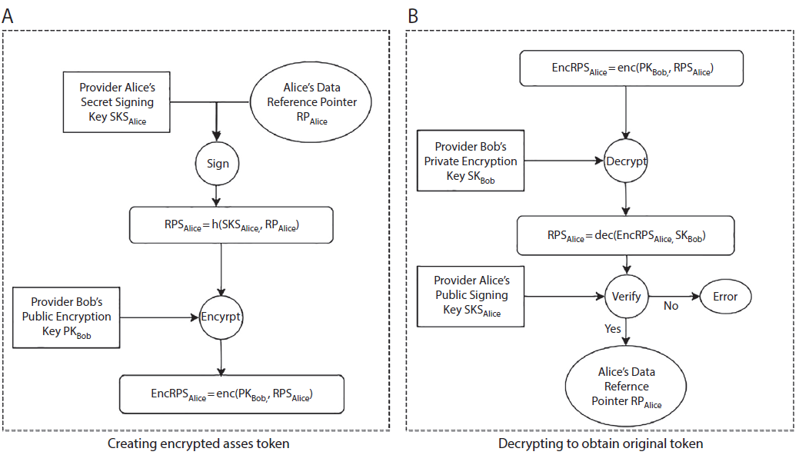
Authentication management:
This scheme utilized a secured public cryptographic scheme “Sing- and encrypt” for Authentication
Stage 1: Generates A Public key for signing transaction
Stage 2: Sign transaction
Stage3: Encrypt transaction using a generated pair key
Stage 4: Stores reference on blockchain for verification

Slide 16
Bubble of trust : Mohamed et al., 2017
Bubble of trust aim to create a secure virtual zone in IoT environment. System rely on a public blockchain that implements smart contract (Ethereum Blockchain).
Characteristics | Ethereum
Permission restrictions | Hybrid
Access to data | Public
Consensus | PoW
Anonymity | Pseudonymity, no encryption of transaction data.
Scalability | High-node scalability, low performance scalability.
Transaction flow

Slide 17
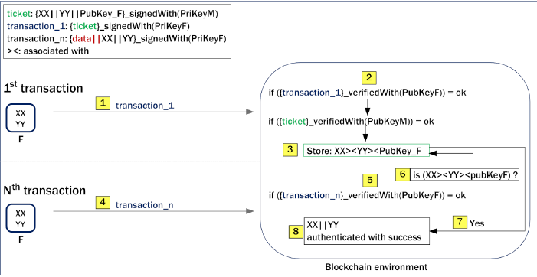
Authentication management: Scheme utilizes Secured public key Cryptography “Elliptic curves signature Algorithm”
Signs transaction with a pair key
Group ID and Object ID
Verify transaction in 2 levels
Stores transaction references
Verify signature keys and grant access

Slide 18
Oncology data sharing system : Alvetine et al., 2016
Proposed a Hyperledger blockchain framework to create a prototype of an oncology-specific clinical data sharing system, to grantee that patient data are completely, stored securely.
Characteristics | Hyperledger
Permission restrictions | Permissioned
Access to data | Private
Consensus | PBTF
Anonymity | Pseudonumity, allows encryption of transaction data
Scalability | Low node scalability, high performance scalability.

Slide 19
Authentication management: Secured public key Cryptography “One-to-one Proxy re-encryption keys”
Key Generation(KG) by Authority holder User ‘A’
pka
ska
Re-Encryption Key Generation (RG)
rkA→B = gb/a ∈ G1
First-Level Encryption and Second Level encryption E1 and E2
c = (Zak, mZk).
c = (gak, mZk).
Decryption (D1, D2).
compute m = β/α1/a. And
m = β/e(α, g)1/a.

Slide 20
AUTOMATED ACCESS-CONTROL MANAGER : Zyskind et al., 2015
This approach implement a protocol that turns a blockchain into an automated access-control manager that does not require trust in a third party. This is achieved by combining blockchain and off blockchain storage to construct a personal data management platform.
Characteristics | Bitcoin
Permission restrictions | Permission-less
Access to data | Public
Consensus | PoW
Anonymity | Pseudonymity, no encryption of transaction data.
Scalability | High-node scalability, low performance scalability.

Slide 21
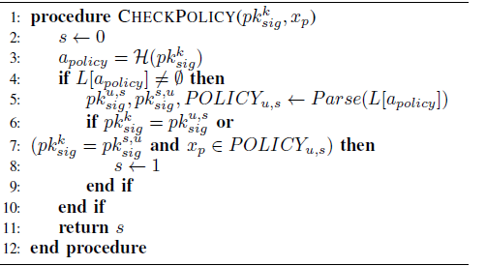
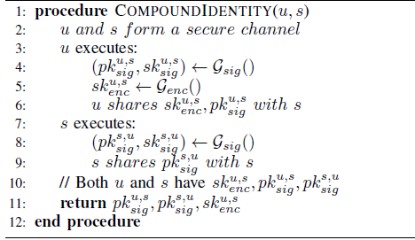
Authentication management: Secured public key Cryptography “sign and encrypt”
Uses signing public key to generate access policy on blockchain
Verifies Originator has the appropriate permissions.
Shared Identities of two or more parties
Signed Public Keys
Encrypted response

Slide 22
Summary Of Authentication Management:
Approach | Disadvantages | Possible solution
FHIRChain Zhang et al., 2018 | Sing then encrypt scheme lacks rigorous definitions for security and privacy of data. (Jee et al., 2002) | Rigorous security and privacy research for signcryption schemes (Jee et al., 2002)
Bubble of trust Mohamed et al., 2017 | No mutual authentication between nodes .(Ning et al., 2014) | Research on algorithms that can provide mutual authentications between nodes.
Oncology data sharing system Alvetine et al., 2016 | Collusion between a malicious server and any single malicious user would expose decryption keys of all the encrypted data and compromise data security and privacy of the system completely. | Need for scheme that protect users keys against malicious users and collusion attack.
AUTOMATED ACCESS-CONTROL MANAGER Zyskind et al., 2015 | Scheme lacks formal proof of model confidentiality. (Baek et al., 2002) | Propose formal security and privacy models

Slide 23
Discussion (BITcoin & Ethereum VS Hyperledger)
Table below depicts advantages of Hyperledger framework Alvetine et al., 2016 over Ethereum and Bitcoin framework in Zhang et al., 2018 , Mohamed et al., 2017 and Zyskind et al., 2015
Characteristics | Bitcoin | Ethereum | Hyperledger
Founded | July 2015 | January 2009 | July 2017
Access to data | Public | Public and private | Private
Scalability | High-node scalability | High-node scalability | Low-Node scalability
In-Built Currency | YES: Bitcoin | YES: Ether | NO
Programming Language | C++ | Golang, C++, Phyton | Golang, Java

Slide 24
Review on existing Cryptographic Schemes
Cryptography
2
Symmetric
Asymmetric
Centralized applications
Decentralized Applications
Public/shared Key cryptography Algorithm
Homomorphic Algorithm
Pair Key cryptography Algorithm
Sign and then encrypt Algorithm
Elliptic curves signature Algorithm
Attribute based encryption
Vertical partitioning Algorithm
Hybrid encryption
One-to-one Proxy re-encryption keys
Zhang et al., 2018, Zyskind et al., 2015
Mohamed et al., 2017
Yoon et al., 2013
Yang, et.al., 2015
Aljawarneh, et al,. 2015
Alvetine et al., 2016

Slide 25
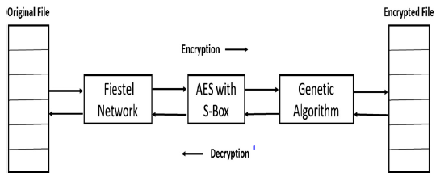
Hybrid encryption technique Aljawarneh, et al,. 2015
Proposed hybrid encryption technique for secure Electronic Health Record (EHR) storage.
Principal resource | Features
Feistel Network: | Arrange, produces a figure key that will be utilized in AES part.
AES with S-box | acknowledges the plaintext and the figured key as info.
Genetic algorithm | utilizes two levels of mixes: hybrid and change. In the hybrid, encrypted text and encryption key are swapped, in Change, bit is flipped in plain text and encryption key.

Slide 26
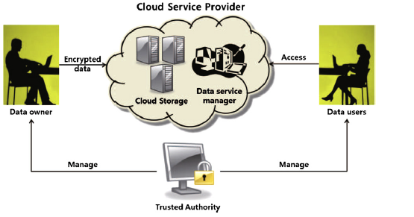
Attribute-Based Symmetric Encryption Approach Yoon et al., 2013
Key Elements | Features
Trusted specialist | A key generation focus with full trust of all members of the framework.
Cloud specialist organization | Data stockpiling the supplier to users that stores the information content redistributed by the information proprietor.
Data proprietor | Sends questions to the specialist organization for encrypted information in the distributed storage framework by utilizing an alias the information proprietor.
Data Client | This is an outsider distributed storage supporter
proposed scheme enables the patient to share safely their personal health records with clients from various security areas.

Slide 27
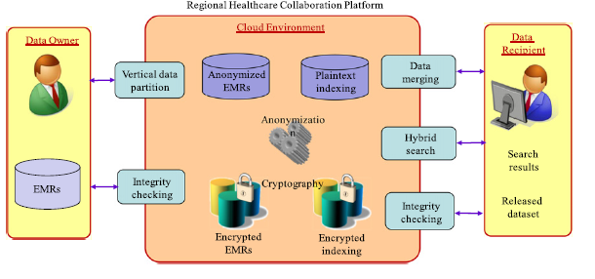
Vertical partitioning and integrity checking of medical dataset Yang, et.al., 2015
This plan proposed an answer that utilizes Symmetric and public key encryption calculation by encoding the information utilizing proficient symmetric key cryptography.
Key Elements | Features
Vertical information parcel | For medicinal information scrambling
Information converging | For access to medical dataset.
Respectability checking | For Dataset honesty level check, and Hybrid Search over encrypted and decrypted data

Slide 28
Discussion Symmetric VS Asymmetric Cryptography
Table below depicts differences between asymmetric used in decentralized application techniques over symmetric used in the centralized techniques
Characteristic | Symmetric | Asymmetric
Hardware | Allows efficient communications between two parties in a closed environment | Enable security in settings in which symmetric encryption does not work
Speed | Faster | Slower
Key Size | Uses 128-bit Symmetric key, considered very secured. | Key size of at least 1000bit.
Security/Privacy Services. | Confidentiality, Authentication | Confidentiality, Authentication

Slide 29
Proposed Solution

Slide 30
Identified privacy issues
Most of current blockchain privacy enhancement solutions:
Manages authentication off-blockchain, leveraging blockchain for ID only.
Lacks authorization models with deterministic outcomes.
Notes:
A deterministic algorithm is an algorithm which, given a particular input, will always produce the same output, with the underlying machine always passing through the same sequence of states.

Slide 31
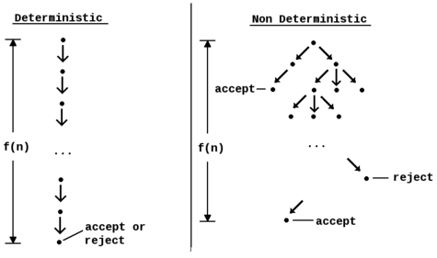
Deterministic VS NON deterministic outcome
Example: Blockchain smart contracts are deterministic models
Performs f(n) steps input, and produces a f(n) steps output on every run.
Takes some levels of f(n) steps input, might not give f(n) steps output on every run

Slide 32
Research Methodology
Explore current blockchain techniques. Based on literature review.
Design a blockchain framework. Under Hyperledger environment.
Propose PKI blockchain authentication algorithm. Leveraging a secured public key cryptography mechanism
Evaluate the proposed framework.
Read latency
Read throughput
Transaction latency
Transaction throughput

Slide 33
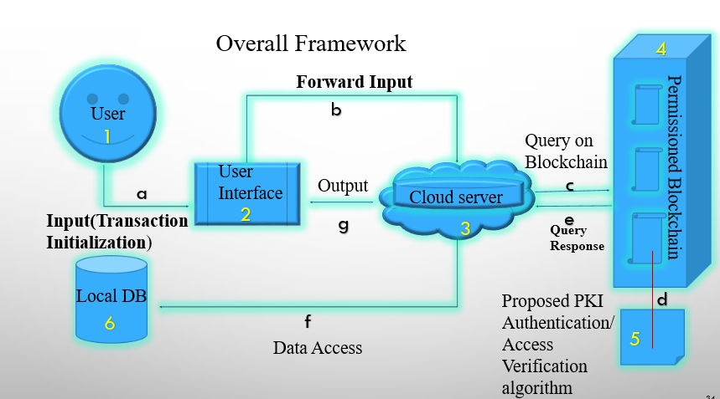
Overall Framework Key
Input(Transaction Initialization)
Forward Input
Query or update on Blockchain
Run Proposed PKI
Query response
Data Access
Output
User
User Interface
Cloud server
Permissioned Blockchain
Proposed PKI
Local database

Slide 34
Contribution to framework: PKI Authentication Scheme
Is:
symmetric cryptography
“commit-then encrypt-and-sign”
Verification Of Transaction Input
Commit transaction.
Encrypt transaction
Sign transaction

Slide 35
Why “commit-then encrypt-and-sign” ?
Solved Problem:
Provides deterministic outcome.
Manage authentication and id check on blockchain.
Verification of transaction
Sign transaction
Decrypt transaction
Output

Slide 36

Algorithm 1: Transaction Commit (Key-GEN, Commit, Open)
Generation of a shared public key Ck and Commit of transaction t with a randomness r using generated shared key Ck
Start procedure ⃪ ck
${Commit}_{Ck}$(t;r) ⃪ t + r
(c,d) ⃪ ${Commit}_{Ck}$ (t)
If (c,d) is valid
Open ⃪ d + ${Commit}_{Ck}$ (t)
${Open}_{(c,d)}$ ⃪ t
End of procedure
Deterministic outcome, verification check for decommit

Slide 37

Algorithm 2: Transaction Encryption (Keygen, Enc, Dec)
Start of procedure
Key-Gen ⃪ (Ek, DK)
Enc → Ek + t
$e_{t}$ ⃪ ${Enc}_{Ek}$ t
{Output after computation}
Dec → $e_{t}$ + Dk
If $e_{t}$ + Dk is valid
Output t ⃪ ${Dec}_{Dk}$ $e_{t}$
Else
Output Error message
Deterministic outcome for decryption

Slide 38
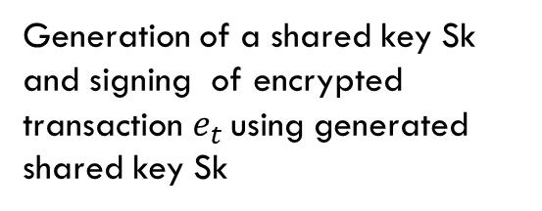

Algorithm 3: Transaction Signature (Keygen, Sign, Ver)
Start of procedure
Key-Gen ⃪ (Sk,)
Sign → Sk + $e_{t}$
$s$⃪ ${Sign}_{Sk}$ $e_{t}$
Ver → $s$+ Sk
If $s$ + Vk is valid
Output a ⃪ ${Ver}_{Dk}$ $s$
Else
Output Error message
Generation of a shared key Sk and signing of encrypted transaction $e_{t}$ using generated shared key Sk
Deterministic outcome for signing keys verification

Slide 39
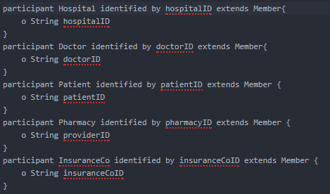
Case Study in healthcare Domain
Dispute resolution parties:
The Hospital (HP)
The Patient
The Doctor
The Pharmacy
The Insurance Company(IC)
PATIENT DATA ATTRIBUTES:
Patient_id
insurance_name
Street_address
Patient_gender
Patient_age
Transaction Example Map
HP
Patient
Doctor
Blockchain
Pharmacy
IC

Slide 40
Patient Identity Registration
Patient
UI
Server
Blockchain
Local DB
Create Id with (patient data attributes)
Forward request
Query request on blockchain
Create public key(commit then encrypt and sign)
Registering encrypted data
Query response
Displaying options for who to share key with.
Display id creation response

Slide 41
Patient Appointment schedule
Patient
UI
Server
Blockchain
Local DB
Query blockchain for data records
Create appointment
Forward appointment details
Get patient public key
If patient keys exist
Return requested key
Display response
Verify and decrypt
Return access token
Write options: Preferred schedule, Available doctor
Access schedules
Displaying options for READ and WRITE on data
Access response

Slide 42
Hospital admin staff Data access Authentication
Staff
UI
Server
Blockchain
Local DB
Query blockchain for data access
Request to manage patient appointment
Get patient public key
Forward request
Return requested key
Verify and decrypt
Display response
Return access token
Manage appointment schedule: doctor schedule, schedule notification.
Access patient data
Access response
Displaying options for READ and WRITE on data

Slide 43
Doctor Data access Authentication
Doctor
UI
Server
Blockchain
Local DB
Query blockchain for data access
Request to access patient data
Get patient public key
Forward Request
If patient keys exist
Return requested key
Verify and decrypt
Display Response
Return access token
Access patient data
Displaying Options for READ and WRITE on data
Access Response

Slide 44
Dataset:
Dataset | Attributes | Descriptions and size | Dataset Citations
The sail data bank/ medicare data: medicare data (bigquery dataset) | id,gender,age,hypertension,heart_disease,ever_married,work_type,Residence_type,avg_glucose_level,smoking_status | Dataset of Health records/12.0GB Dataset Source: Center for Medicare and Medicaid Services. | [1,2,3,4,]
Home medical visits - healthcare : Medicare data (bigquery dataset) | provider_id, agency_name,street_address,city, state, zip_code,total_episodes_non_lupaTotal ,distinct_users_non_lupaNumber ,total_hha_charge_amount_non_lupa,total_hha_medicare_payment_amount_non_lupa,total_hha_medicare_standard_payment_amount_non_lupa,outlier_payments_as_a_percent_of_medicare_payment_amount_non_lupa,total_lupa_episodes,total_hha_medicare_payment_amount_for_lupas. | Dataset of Health records/256.5 GB Dataset Source: information collected of a Home Medical Services Company located in the metropolitan area of Barcelona(Spain). | [9,10,11,12,13]

Slide 45
Evaluation architecture (Mahesh et al., 2018 , Ingo et al., 2017, Mohamed et al., 2017)
BLOCKCHAIN PLATFORM
Simulation application setup
Simulation pre-configuration
Workload evaluation
Performance data collection
Sends transactions to the blockchain platform
Collects transaction status

Slide 46
Simulation assumptions:
Simulation result is generated using OMNeT++ 4.5,with the dedicated network simulation (Veins) packet. Performance evaluation is broken into three parts
PKI processing time components, namely encryption, decryption, signing, commit, block mining.
The comparison of processing time results between Hyperledger and Ethereum blockchain
Study of the processing time in blockchain network against different transaction collection periods.

Slide 47
Evaluation Measures: (Mahesh et al., 2018 , Ingo et al., 2017, Mohamed et al., 2017)
MEASURES | DESCRIPTION | FORMULAR
Read Latency | Read latency is the time between when the read request is submitted and when the reply is received. | Read Latency = Time when response received – submit time
Read Throughput | Read throughput is a measure of how many read operations are completed in a defined time period. | Read Throughput = Total read operations / total time in seconds
Transaction Latency | Transaction Latency is a network-wide view of the amount of time taken for a transaction’s effect to be usable across the network. | Transaction Latency = (Confirmation time @ network threshold) – submit time
Transaction Throughput | Transaction throughput is the rate at which valid transactions are committed by the blockchain nodes in a defined time period. | Transaction Throughput = Total committed transactions / total time in seconds @ #committed nodes

Slide 48
Preliminary TEST
Hyperledger Blockchain
N request of transaction type f are configured for simulation
Number of transactions are set to 50, 100, 150 and 200. Transaction type is set to Patient_Identity_Registration, Patient_Appointment_Shedule, Access_Authentication
Transaction data simulated by randomization and result of each experiment are averaged over 10 independent runs

Slide 49
Preliminary Results
Average public key processing time:
Average block formation time with respect to transaction number:
PKI Scheme | Processing Time(Milliseconds)
Encryption | 0.5102
Decryption | 0.7399
Signing | 0.5101
Commit | 1.1017
Transaction number | Formation Time(Milliseconds)
50 | 0.0013
100 | 0.0035
150 | 0.0072
200 | 0.0133

Slide 50
Gantt Chart
Current stage
Activity | 2018-2020
 | Apr - May | Jun - Jul | Aug - Sep | Oct - Nov | Dec - Jan | Feb - Mar | Apr - May | Jun - Jul | Aug - Sep | Oct - Nov | Dec - Jan | Feb - Mar
Literature Review
Design and dev of hyperledger node
Design and dev of public key interface
Design and dev of the framework
Data Gathering/ Preprocessing
Prototype development
Prototype testing
Prototype evaluation
Result Analysis and Report Writing

Slide 51
Work done
Literature review on blockchain, privacy issue and decentralized technology.
Design on the Hyperledger network to create a 4 distributed ledger node pools.
Design and development of the framework
Work to be done
Data gathering and preprocessing
Refinement of framework
Prototype development, testing and evaluation
Result analysis and Report writing.

Slide 52
Conclusion
Big data privacy issues through literature study:
Centralization of existing privacy enhancement techniques.
Manages authentication off-blockchain, leveraging blockchain for id only.
Lacks authorization mechanism for blockchain requirements of model with deterministic outcomes.
RO1 Deliverables:
RO2 Deliverables :
Proposed framework:
Manages authentication and identity of users on blockchain leveraging a cryptographic public key interface (PKI).
Provides a model with deterministic outcome.
ONGOING
Performance evaluation :
Efficiency test
Effectiveness evaluation
RO3 Deliverables :
ONGOING

Slide 53
Publication
Tahir Yinka, Olaosebikan , Su-Cheng Haw ,Gaik-Yee Chan , (2018). Enhancing Privacy for Big Data in Healthcare Domain: A Review on Cryptographic and Decentralized Technology Approaches, International Conference on Advance Science, Engineering and Technology. MECON 2019
Published

Slide 54
References
[1] G. Zyskind, O. Nathan, and A. Pentland, “Decentralizing Privacy: Using Blockchain to Protect Personal Data”, IEEE Security and Privacy Workshops, 2015.
[2] S. Aljawarneh, M.B. Yassein, and W.A. Talafha, “A resource-efficient encryption algorithm for multimedia big data”, Multimedia Tools and Applications, 76(21), 2015, pp. 22703–22724.
[3] M. Hilbert, “Big Data for Development: A Review of Promises and Challenges Development Policy Review”, 34(1), pp. 135–174, 2015.
[4] R. Sugumar, “Symmetric Encryption Algorithm to Secure Outsourced Data in Public Cloud Storage”, Indian Journal of Science and Technology, .vol. 8, issue. 23, 2015.
[5] K. Suveetha, and T. Manju, “Ensuring Confidentiality of Cloud Data using Homomorphic Encryption”, Indian Journal of Science and Technology, vol. 9, issue 8, 2016.
[6] I. Sukhodolskiy, and S. Zapechnikov, “A blockchain-based access control system for cloud storage”, IEEE Conference of Russian Young Researchers in Electrical and Electronic Engineering, 2018.
[7] T.T. Kuo, H.E. Kim, and O.M. Lucila,"Blockchain distributed ledger technologies forbiomedical and health care applications", Journal of the American Medical Informatics Association, vol. 24, issue 6, 2017.
[8] J. Brogan, I. Baskaran, and N. Ramachandran, “Authenticating Health Activity Data Using Distributed Ledger Technologies”, Computational and Structural Biotechnology Journal, 16, 2018, pp. 257–266.
[9] S. Alshehri, S.P. Radziszowski, and R.K. Raj, “Secure Access for Healthcare Data in the Cloud Using Ciphertext-Policy Attribute-Based Encryption”, IEEE 28th International Conference on Data Engineering Workshops, 2012.
[10] D. Koo, J. Hur, and H. Yoon, “Secure and efficient data retrieval over encrypted data using attribute-based encryption in cloud storage”, Computers & Electrical Engineering, vol. 39, issue 1, 2013, pp. 34–46.
[11] M. Chen, Y. Qian, J. Chen, K. Hwang, S. Mao, and L. Hu, “Privacy Protection and Intrusion Avoidance for Cloudlet based Medical Data Sharing”, IEEE Transactions on Cloud Computing, vol. 1, issue 1, 2016.
[12] J.J. Yang, J.Q. Li, and Y. Niu, “A hybrid solution for privacy preserving medical data sharing in the cloud environment”, Future Generation Computer Systems, vol. 43-44, 2015, pp. 74–86. doi:10.1016/j.future.2014.06.004
[13] S.K. Pasupuleti, S. Ramalingam, and R. Buyya, “An efficient and secure privacy-preserving approach for outsourced data of resource constrained mobile devices in cloud computing”, Journal of Network and Computer Applications, 64, 2016, pp. 12–22.

Slide 55
Thank You

Slide 56
Simulation assumptions:
Simulation result is generated using OMNeT++ 4.5,with the dedicated network simulation (Veins) packet. Performance evaluation is broken into three parts
PKI processing time components, namely encryption, decryption, signing, commit, block mining.
The comparison of processing time results between Hyperledger and Ethereum blockchain
Study of the processing time in blockchain network against different transaction collection periods.
Efficiency
Effectiveness

Slide 57
Average processing time comparison between Hyperledger and Ethereum blockchain:
Blockchain | Read Latency(ms) | Read Throughput (ms) | Transaction Latency (ms) | Transaction Throughput (ms)
Hyperledger | 0.004 | 0.005 | 0.004 | 0.001
Ethereum | - | - | - | -
ONGOING

Slide 58
Average public key processing time:
Average block formation time with respect to transaction number:
PKI Scheme | Processing Time(Milliseconds)
Encryption | 0.5102
Decryption | 0.7399
Signing | 0.5101
Commit | 1.1017
Transaction number | Formation Time(Milliseconds)
50 | 0.0013
100 | 0.0035
150 | 0.0072
200 | 0.0133
Mahesh et al., 2018
Average public key processing time:
Average block formation time with respect to transaction number:
Transaction number | Formation Time(Milliseconds)
50 | 0.0025
100 | 0.0039
150 | 0.00077
200 | 0.0150
PKI Scheme | Processing Time(Milliseconds)
Encryption | 0.5304
Decryption | 0.7556
Signing | 0.5458
Commit | 1.4773

Slide 59
Simulation assumptions:
Our result is generated using OMNeT++ 4.5,with the dedicated network simulation (Veins) packet. Performance evaluation is broken into three parts
PKI processing time components, namely encryption, decryption, signing, commit, block formation.
The comparison of processing time results between Hyperledger and Ethereum blockchain
Study of the processing time in blockchain network against different transaction collection periods.
Simulation of the time cost for different cryptographic schemes.
Compare Hyperledger blockchain with the Ethereum blockchain schemes in Zhang et al., 2018 and Zyskind et al., 2015..
To confirm the effectiveness of the transaction collection period, a simulation experiment will be carried to investigate the average processing time of key transfer in 1 s.

Slide 60
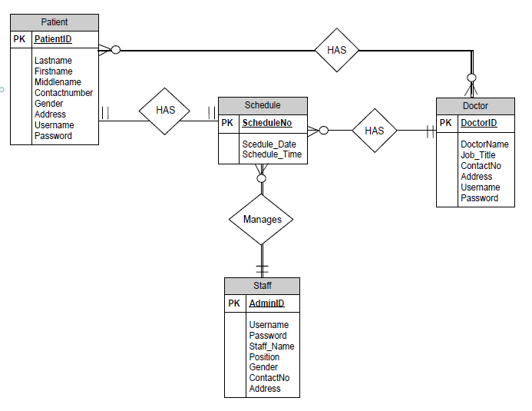
Data Model

